Slide 1
MVA – Market Variance Analysis Aug 2017

Slide 2
A large CPG wants to optimize marketing investments across channels to drive share and profitability
Design Market-Level investment strategy for
01
02
03
Consumer marketing (media, digital)
Customer discounts and allowances
Sales Assets
(like machines)
1. To gain value share
1. Volume Drivers and Comparison by Channel
Objective
KPIs
2. Marketing ROI
2. To generate returns
3. Value Share of NARTD* Beverages

Slide 3
Holistic approach to upgrading your MVA
Non-linear modeling to improve attribution
Reproducible research and re-use for scale
Driving efficiency in simulation and optimization

Slide 4
Business wants to take a holistic approach to upgrading their MVA
There is a need to benchmark multiple non-linear techniques to assess model performance
There is a need to improve the efficiency of existing simulation and optimization process
The CPG customer’s MVA is responsible for optimized allocation of budget to different media channels to maximize ROI
The MVA model in use is supported with linear techniques along with simulation and optimization
The team wants to take a holistic approach to understand the scope for driving further efficiency in their MVA process
Outcome: The team is able to improve the efficiency of market mix with improved attributions delivered
Behavior: The team undertakes upgradation of existing models based on benchmarked improvements with recommended changes
Insights:
Functional forms for non linear components like carry over effects and diminishing returns
Efficiency booster for simulation and optimization
What are the applicable non-linear techniques for market mix modeling in client context?
How can we perform rapid experimentation in upgrading the models?
What drives efficiency in simulation and optimization?
Notes:
Change channel

Slide 5
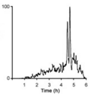
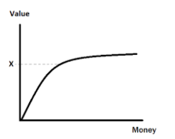
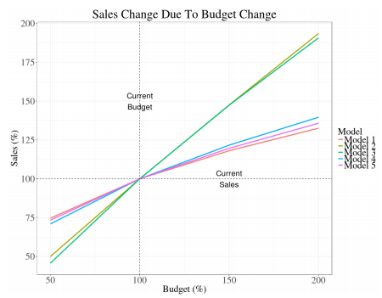
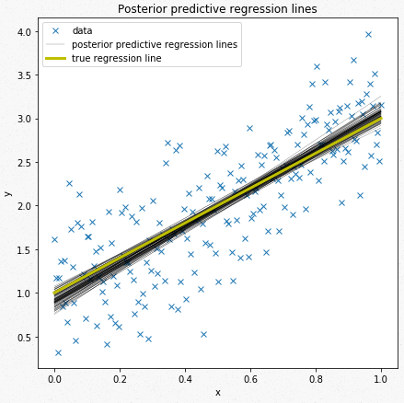
We will make enhancements to existing models to account for non-linear effects, selection biases and uncertainty
Selection Bias
Input media variable is correlated with an unobservable demand variable, which in turn drives sales
Ad-targeting & Funnel Effects
Non Linear Effects
Effects like impact of past ads on current sales and diminishing returns of ads on sales are difficult to incorporate using linear models
Carryover Effect Shape Effects
Enriched 2-Step Models
Developed multiple transformation techniques on strong foundation of reproducible research
Uncertainty in Models
Usually there are several plausible models for a given set of data which have around the same error values, a framework is required which is able to quantify this uncertainty
Implemented multiple modeling techniques to substantiate beta estimates and reflect confidence around them

Slide 6
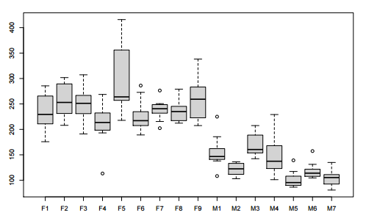

We will address the mixed effects of MVA levers on volume/value share across geographies by using panel methods
Mixed effect model Allows one to pool data for various products in the category which can be used to model
similarly behaving products
CPO
(run at a segment, category and region level)
Fixed Effects
Factors that have effects that resonate similarly across the entire market
Price
Volume and Penetration tend to drop with an increase in Price
Execution
Sales is expected to increase with more retail execution
Seasonality
The effect of temperature will be the same for all products in the market
Random Effects
Factors that will have a specific effect on individual elements in the market
Random Effect (Price|Packaging) how price varies by packaging
Feature Ads | Packaging
It will only affect the sales of individual elements in the market
Fixed Effect (Seasonality) shown by the entire category
Price | Packaging
Price may have a random effect (varying by individual products, areas) on the elements

Slide 7
A plethora of response variables, depending on business priorities, can be used to gauge the market reaction
Metric | Definition | Unit of Measurement | Applicability
Penetration | # of households purchasing Business category v/s total household base for the category | Percentage | Identification of untapped potential in terms of households
Incidence | # of households consuming Business category v/s # of households purchasing in the Business category | Percentage | Identify drinker base for each category
Market Potential | # of households purchasing in the category * Avg. weekly consumption No Purchase- market Potential-Actual Volume purchased | EQ volume | Identifying the untapped potential in terms of volume
Buying Rate | Average volume of product purchased per household over a period of time | EQ volume/HH | Understanding of how much a customer is willing to spend in the category over a fixed time
Purchase Size | Average volume of product purchased by a household in one transaction | EQ volume/HH | Help in deciding thresholds for offer type
Purchase Frequency | Average # of times a household purchases a product over a period of time | # of purchases/HH | Understanding of high demand/consumption products
Interpurchase Interval | Average time between consequent purchases for a household | Days/Months/Years | Understanding of the time required for a product to be consumed
New Households | # of households purchasing in the category first time (can be defined as first time in a defined period) | # of HH | Acquisition rate, switch from competition
Cross Purchasing Households | # of households purchasing cross category | # of HH | Useful for bundling strategies, promotion schemes

Slide 8


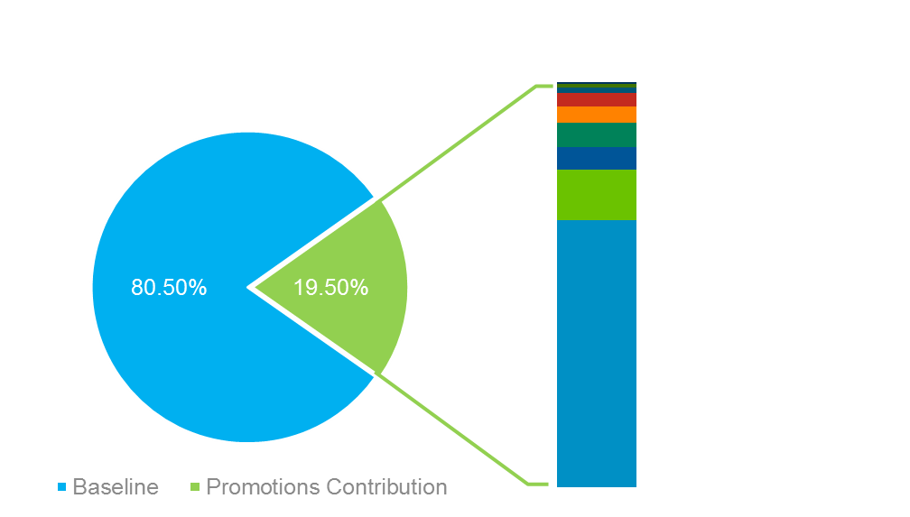










High quality reducible outcomes will be delivered through a custom stack deployed in house
Business Team
Analyst Team
Hypothesis Library
EDA Report
Outliers Report
QC Report
Optimization tool using RShiny
Interactive Dashboard using Tableau
Slide library
Consumption
MVA Modeling Notebook
Iteration Manager
ADS Notebook
Batch Processing System
Analysis & Model Building
Data processing & integration to create the final ADS for modelling
QC Brick
EDA Brick
BPM
End-to-End Automation
Data Processing
Flat files
Data on Cloud
Database/Data Warehouse
Disparate Data Sources
Budget file
Sales Data
Spends data
Activity Data
Mapping files

Slide 9
Scale: Executed multiple projects using a 2-step MMx methodology and enriched it using further advanced techniques
Enriched 2-Step Models
Challenges faced across markets
Linear-Log
Developed multiple transformation techniques on strong foundation of reproducible research
Linear-Linear
Log-Log
Time Trend Variable
Dummy Variable
Interaction Variable
Sporadic investment in channels
Multi- Collinearity
Stable baseline
Implemented multiple modeling techniques to substantiate beta estimates and reflect confidence around them
Partial Least Squares
Multivariate Additive Regression Splines (MARS)
Ordinary Lease Squares (OLS)
We anticipate these to recur as we scale, and have explored and built capability to tackle them
Mixed Effects (LME)
Generalized Additive Model (GAM)
Bayesian Hierarchical Model

Slide 10
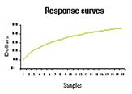
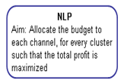
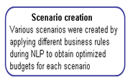
Example: Mu Sigma helped a leading pharmaceutical company scale MVA across 6 geographies
Key Findings
Analysis Illustrations
The analysis revealed that promotion via non personal channels was less profitable compared to other personal promotions
It also helped to identify non-responsive geographical regions and hence suggested to revise the promotional spend on those areas
Response and cost associated with each promotional channel for every cluster was used as an input to optimization
Non linear programming was used to allocate the budget to every channel such that overall profit is maximized and not from the individual channel
Business Impact
The modeling exercise helped in determining the relative impact of personal and non personal promotions on the prescription volumes of each physician segment
The optimization process and the channel-wise expected ROI gave the client context on what profits to expect in the following year

Slide 11



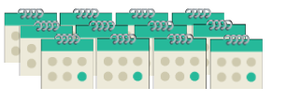
Using the linear mixed model as a predictive engine, a framework is built that can compare thousands of promotional plans to identify the best ones
Input to Simulator
Mixed Effects Modelling
Interpreting Simulator Output
(A base plan input by a business user and 1000s of plans are generated by a randomization algorithm)
(Advanced analytics was leveraged to model factors that will help determine promo effect)
Base Plan for the time period
Fixed Effects
Value of the week
“Was this a great week or a great promo?”
“How did the retail price
compare to recent weeks?”
Reference price
Created based on user’s business knowledge
Execution
“Was display support better or worse than average?”
Random Effects
2) Deep-dive into those plans to ensure that the plan is driving growth without causing cannibalization effect amongst its product line*
1000s of Algorithmically generated plan scenarios for the quarter
“How did competitive promos affect our (and retailer) results?”
Competition
Stocking Effect
“What happens to the sales in weeks after a heavy discount?”
Price
“How does the effect of price
vary across different panels?”
Encompasses +150 CTAs, +30 product
lines, +4 years
Business restraints incorporated
Predicted Output for that scenario
Profit Margins
Revenue
Household penetration

Slide 12





All input files need to be laid out in a pre-determined format in one location
Mapping Files
Future Datasets
Week mapping
Package mapping
COD lookup
COGS lookup
Redemption Rate
Future Dataset for each of the CTA-Category-Segment that we want to simulate
Input Files
Coefficients
All the scenarios generated kept in Input folder
Coefficient files at CTA-Category- Segment level
There are 4 for each (volume and penetration and their revised) CTA-Category-Segment

Slide 13
Scenario generation code uses a file with all possible promotions for each Package – week combination
Scenario generation code requires a file with all possible promotions for each Package – week combination
Category | Package Size | Store | Promotion | Week | Every Day Value | Communicated_Price | Case_on_display (T/F) | Feature | Dead Net Selling Income
Sparkling Soft Drinks | Pack 1 | AB | Simple | 8/7/2016 | 4.99 | 1.623696632 | 0 | 1 | 4.915058037
Sparkling Soft Drinks | Pack 1 | AB | Buy 2 Get 1 | 8/7/2016 | 4.99 | 2.128086216 | 0 | 1 | 4.53985985
Sparkling Soft Drinks | Pack 1 | AB | Buy 2 Get 2 | 8/7/2016 | 9.29 | 4.019604121 | 0 | 1 | 7.996531438
Sparkling Soft Drinks | Pack 2 | AB | Simple | 8/7/2016 | 4.99 | 1.623696632 | 0 | 1 | 4.915058037
Sparkling Soft Drinks | Pack 2 | AB | Buy 2 Get 1 | 8/7/2016 | 4.99 | 2.128086216 | 0 | 1 | 4.53985985
Sparkling Soft Drinks | Pack 2 | AB | Buy 2 Get 2 | 8/7/2016 | 9.29 | 4.019604121 | 0 | 1 | 7.996531438

Slide 14
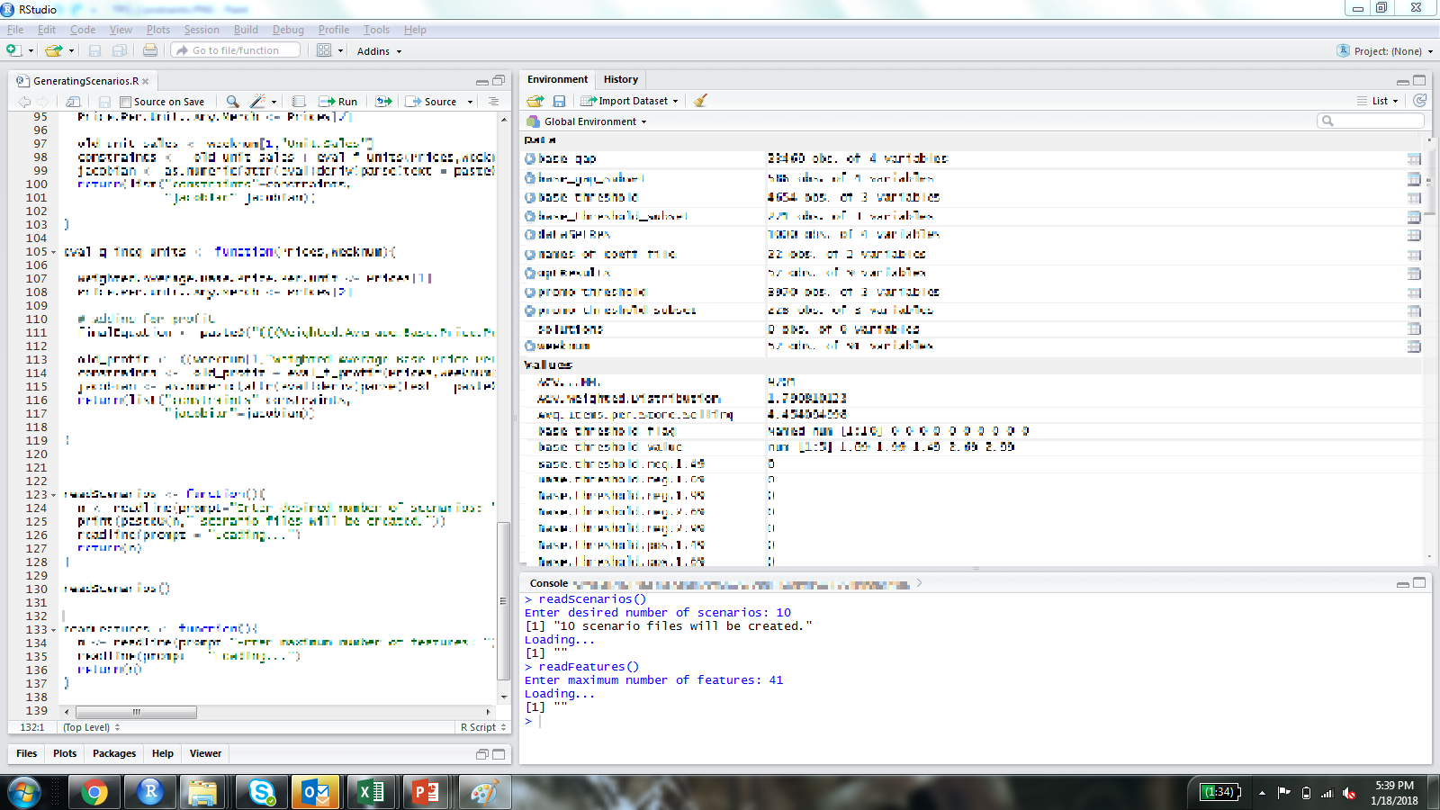
Code designed to take the number of scenarios and business constraints from the user
User inputs number of scenarios in master file and total number of features to be applied

Slide 15
Algorithmically generated scenarios used to compare against the base plan using the comparison code
The generated file has all weeks with a unique promotion series for each pack.
This file is given as an input to the scenario comparison code
Category | Package Size | Store | Promotion | Week | Every_Day_Value | Communicated_Price | Case_on_display (T/F) | Feature | Dead Net Selling Income
Sparkling Soft Drinks | Pack 1 | AB | Buy 2 Get 1 | 8/7/2016 | 4.99 | 1.623696632 | 0 | 1 | 4.915058037
Sparkling Soft Drinks | Pack 1 | AB | Buy 2 Get 1 | 8/14/2016 | 4.99 | 2.128086216 | 0 | 1 | 4.53985985
Sparkling Soft Drinks | Pack 1 | AB | Buy 2 Get 2 | 8/21/2016 | 9.29 | 4.019604121 | 0 | 1 | 7.996531438
Sparkling Soft Drinks | Pack 1 | AB | Buy 2 Get 1 | 8/28/2016 | 4.99 | 2.063410958 | 0 | 1 | 4.656140061
Sparkling Soft Drinks | Pack 1 | AB | Simple | 9/4/2016 | 8.19 | 3.548984713 | 0 | 1 | 5.326762791
Sparkling Soft Drinks | Pack 1 | AB | Simple | 9/11/2016 | 8.19 | 3.659548458 | 0 | 1 | 5.602928247
Sparkling Soft Drinks | Pack 1 | AB | Simple | 9/18/2016 | 10.99 | 8.536719338 | 0 | 0 | 6.324666395
Sparkling Soft Drinks | Pack 1 | AB | Simple | 9/25/2016 | 10.99 | 8.57878255 | 0 | 0 | 5.818404778
Sparkling Soft Drinks | Pack 1 | AB | Simple | 10/2/2016 | 10.99 | 8.603300418 | 0 | 0 | 5.922434793
Sparkling Soft Drinks | Pack 1 | AB | Buy 2 Get 1 | 10/9/2016 | 8.19 | 3.629671316 | 0 | 0 | 6.655852703
Sparkling Soft Drinks | Pack 1 | AB | Simple | 10/16/2016 | 10.99 | 7.853011211 | 0 | 0 | 5.737572588
Sparkling Soft Drinks | Pack 1 | AB | Simple | 10/23/2016 | 10.99 | 8.5157853 | 0 | 0 | 5.738833386
Sparkling Soft Drinks | Pack 1 | AB | Simple | 10/30/2016 | 10.99 | 7.797316668 | 0 | 0 | 6.01351096
Sparkling Soft Drinks | Pack 2 | AB | Buy 2 Get 1 | 8/7/2016 | 8.19 | 3.868379759 | 0 | 0 | 6.724427973
Sparkling Soft Drinks | Pack 2 | AB | Simple | 8/14/2016 | 10.99 | 8.346829031 | 0 | 0 | 5.498311289
Sparkling Soft Drinks | Pack 2 | AB | Buy 2 Get 1 | 8/21/2016 | 4.99 | 1.751710531 | 0 | 1 | 4.781231313
Sparkling Soft Drinks | Pack 2 | AB | Buy 2 Get 2 | 8/28/2016 | 9.29 | 3.284494712 | 0 | 1 | 7.70331796
Sparkling Soft Drinks | Pack 2 | AB | Buy 2 Get 2 | 9/4/2016 | 4.99 | 1.804932152 | 0 | 1 | 4.600924613
Sparkling Soft Drinks | Pack 2 | AB | Buy 2 Get 1 | 9/11/2016 | 4.99 | 1.66136991 | 0 | 1 | 5.290091691
Sparkling Soft Drinks | Pack 2 | AB | Buy 2 Get 2 | 9/18/2016 | 4.99 | 1.719974087 | 0 | 1 | 4.534421791
Sparkling Soft Drinks | Pack 2 | AB | Simple | 9/25/2016 | 9.29 | 3.706018011 | 0 | 1 | 8.188395387
Sparkling Soft Drinks | Pack 2 | AB | Buy 2 Get 1 | 10/2/2016 | 4.99 | 1.453245296 | 0 | 1 | 5.054035641
Sparkling Soft Drinks | Pack 2 | AB | Buy 2 Get 1 | 10/9/2016 | 4.99 | 1.58237558 | 0 | 1 | 5.039617014
Sparkling Soft Drinks | Pack 2 | AB | Simple | 10/16/2016 | 4.99 | 1.716348151 | 0 | 1 | 5.014154957
Sparkling Soft Drinks | Pack 2 | AB | Buy 2 Get 1 | 10/23/2016 | 4.99 | 1.623696632 | 0 | 1 | 4.915058037
Sparkling Soft Drinks | Pack 2 | AB | Simple | 10/30/2016 | 4.99 | 2.128086216 | 0 | 1 | 4.53985985

Slide 16
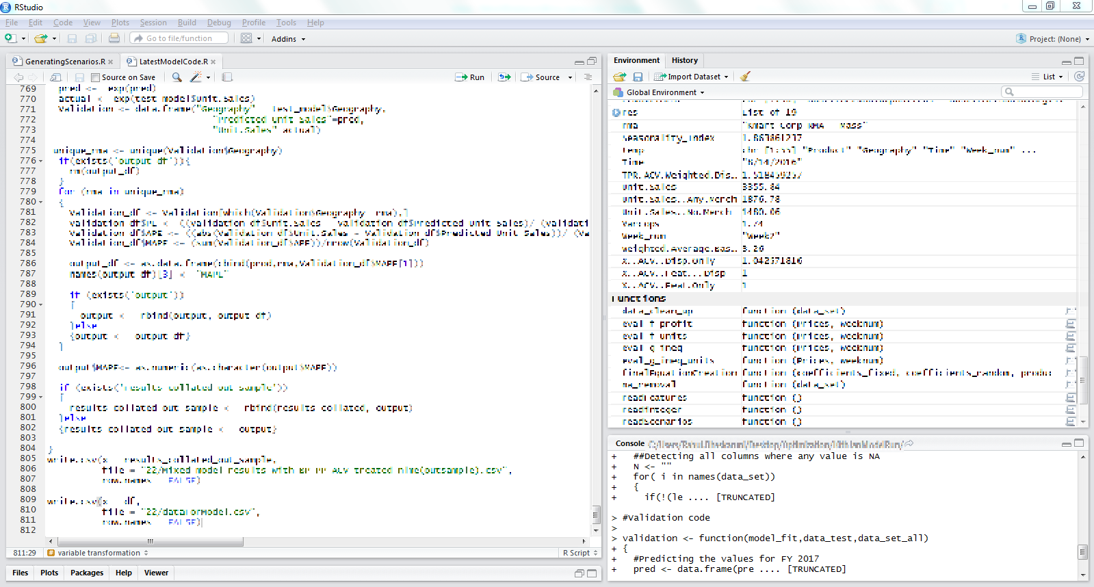
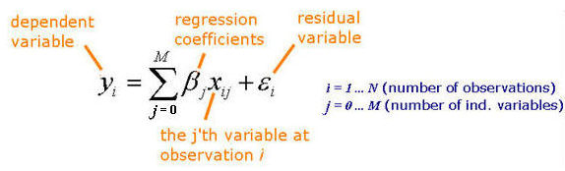
Run code to generate two output files showing comparison between base plan and generated scenarios
Comparison code uses mixed models to predict financial metrics for each of the generated scenarios and compare them with that of the base plan

Slide 17
Output 1: Aggregated comparison between scenarios
input_file | Change in Vol | Change in Penetration | Change_in_HouseHold_ld | Change_in_Revenue | Change_in_COGS | Change_in_Profit | Perc_Change_Revenue | Perc_Change_Volume | Delta Trade
Sparkling Soft Drinks_Safeway_Scenario_1.csv | (88.10) | (0.00) | (42.71) | (612.84) | (251.77) | (41.00) | -6% | -6% | (12.13)
Sparkling Soft Drinks_Safeway_Scenario_2.csv | 101.10 | 0.00 | 49.71 | 591.04 | 361.05 | 61.05 | 6% | 2% | 254.30
Sparkling Soft Drinks_Safeway_Scenario_3.csv | (69.10) | (0.00) | (87.71) | (945.81) | (228.77) | (41.00) | -6% | -6% | (56.13)
Sparkling Soft Drinks_Safeway_Scenario_4.csv | (80.10) | (0.00) | (2.71) | (945.81) | (21.77) | (332.05) | -6% | -6% | (54.30)
Sparkling Soft Drinks_Safeway_Scenario_5.csv | (44.10) | (0.00) | (40.71) | (495.05) | (251.77) | (461.05) | -6% | -6% | (22.30)
Sparkling Soft Drinks_Safeway_Scenario_6.csv | (22.10) | (0.00) | (44.71) | (272.95) | (21.77) | (22.05) | -6% | -6% | (24.30)
Sparkling Soft Drinks_Safeway_Scenario_7.csv | (11.10) | (0.00) | (43.71) | (112.24) | (251.77) | (361.05) | -6% | -6% | (54.30)
Sparkling Soft Drinks_Safeway_Scenario_8.csv | 32.10 | 0.01 | 42.71 | 789.76 | 361.05 | 11.05 | 6% | 2% | 42.90
Sparkling Soft Drinks_Safeway_Scenario_9.csv | (43.10) | (0.00) | (21.71) | (765.84) | (25.77) | (61.05) | -6% | -6% | (2.30)
Sparkling Soft Drinks_Safeway_Scenario_10.csv | (43.10) | (0.00) | (27.71) | (912.94) | (31.77) | (11.05) | -6% | -6% | (45.30)
Insight: Consider scenarios 2 & 8 over the base scenario as they have an incremental change in outcomes when compared to the base

Slide 18
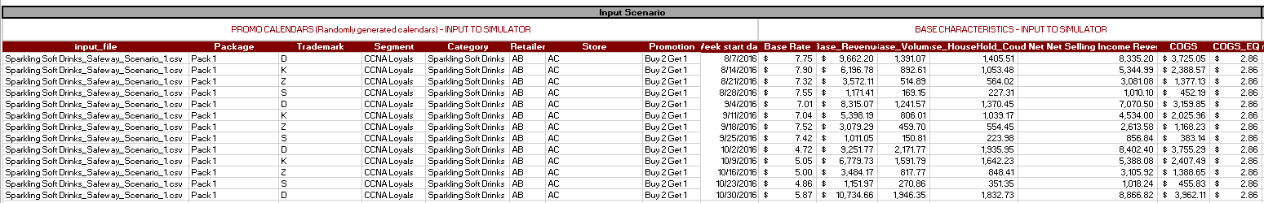
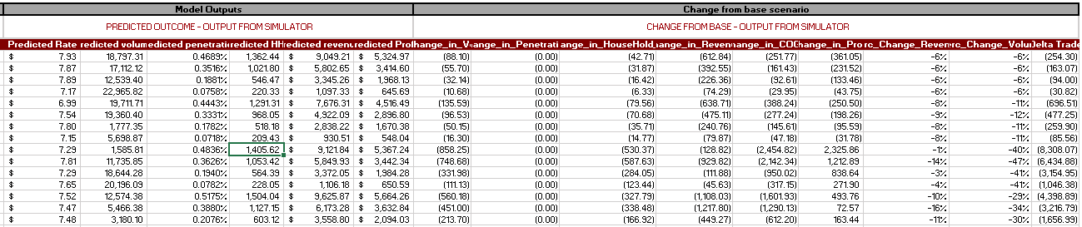
Output 2: In depth comparison between scenarios

Slide 19
Rich and diverse experience of executing analytics projects enables Mu Sigma to identify potential risks and mitigation tactics
Risk | Mitigation | Likelihood | Impact
Delay in getting data and access | Work with client team for realistic estimates Proactive communication & raise flags early | High | High
Data unavailability | Carry out qualitative analysis Proactive communication and raise flags early | High | High
Access to Data SME and Business SME | Include this aspect as one of the project milestones Schedule meets with SMEs and get them to participate and escalate in case of failure | Low | High
Delay in client responsiveness on feedback and reviews | Ensure that meetings are scheduled on everybody’s calendar Proactive communication & raise flags early | Low | High
Scope creep | Clearly define specs Engage in contingency planning with respect to estimation Define appropriate change management procedures | Low | High

Slide 20
Thank You

Slide 21
Current Marketing Mix Modeling Approach
Say NO to OLS in Favor of Panel Estimation Approaches using Bayesian Shrinkage Estimators to improve coefficient interpretability
Linear Mixed Effect Models: Proc MIXED in SAS or LME() or BRMS (Bayesian Mixed Regression) in R
Random Coefficients
Multi-level repeated measure models
Pre-defined functional model form and distributed lag functions are estimated

Slide 22
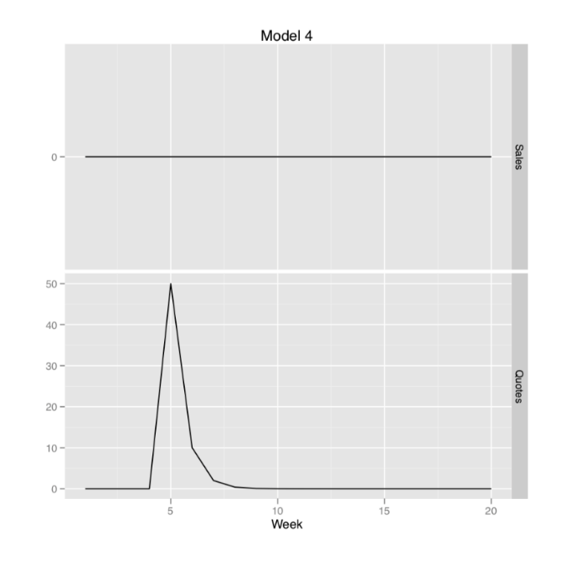
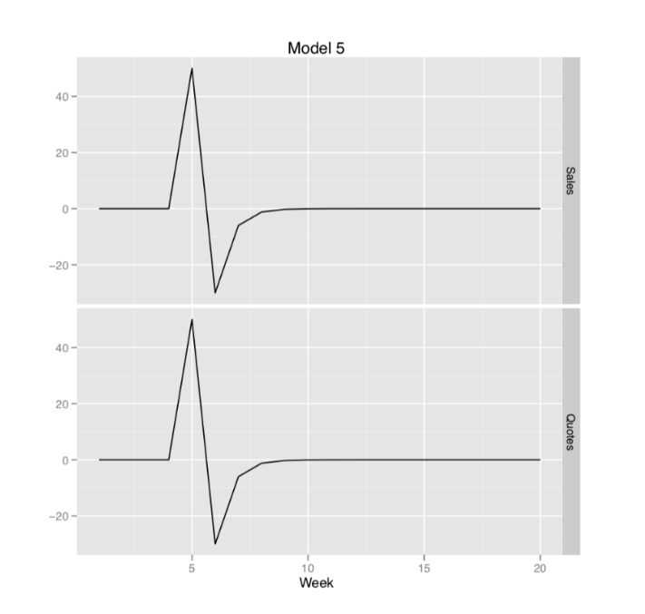
Next Generation Marketing Mix Modeling
Semi-Parametric Methods to estimate functional forms
GAM or MARS, GAMM Bayesian Belief Networks: Probabilistic based SEM
Direct and Indirect effects and latent variables
Dynamic Linear Models: Improved Estimation of Advert Effects
See paper ART Forum 2011 (Vanderbilt University, unpublished)
Time Varying Coefficients / Regimes
Vector Auto Regression, study impulse curves
Latent Class Regression
Machine Learning and Ensemble approaches
Use Bootstrapped Contribution Estimation (no beta)
Improved methods of Simulation & Optimization
Agent Based with Competitor response
Meta heuristic search methods (Simulated Annealing & Particle Swarm)
Flighting strategies

Slide 23
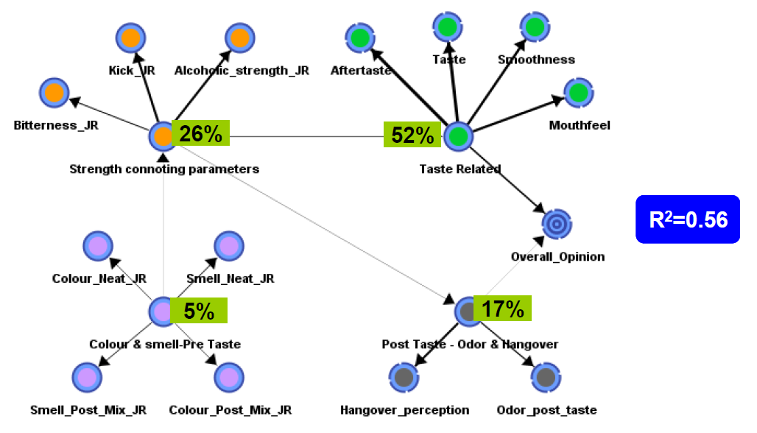
Example: Probabilistic Structural Equation Model Quantifying Contributions to Overall Opinion
Notice Direct and Indirect Relationships Between Factors Are Identified
A Network of Relationships Are “Grown” from the Underlying Data

Slide 24

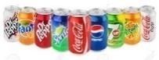
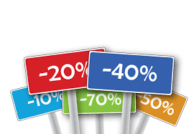


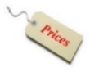

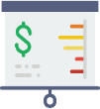

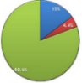
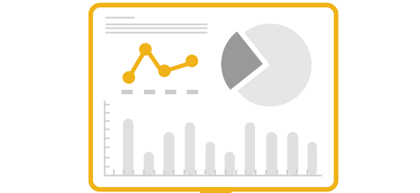
The team followed a planned roadmap to build a simulator to quantify and compare promotional effectiveness
01
Data Gathering & Prep
02
Segmentation & Clustering
03
Model Building
Gather all sources of data and perform ETL queries
Remove outliers and create behavioral segments
Build models for each retailer at CTA, category, segment level
Brand Preference
Promotions
Product Features
Brand Loyal
Brand Switchers
Category Preference
Occasional Incidence
Competitor Loyal
Customer Loyalty
Sales
*PoS Data*
Infrequent
04
Model Insights
05
Prepare Simulator
06
Re-planning
Understand brand, package, and offer preferences per segment
Gather, generate, and load required files for simulator
Leverage model insights to run scenarios
Brand
Package
Current Promotion Plan
Re-planning dataset
Offer
Redemption Rate dataset
Lookup tables

Slide 25
Scenario generation code uses a file with all possible promotions for each Package – week combination
Scenario generation code requires a file with all possible promotions for each Package – week combination
Category | Package Size | Store | Promotion | Week | Every_Day_Value | Communicated_Price | Case_on_display (T/F) | Feature | Dead Net Selling Income
Sparkling Soft Drinks | Pack 1 | AB | Simple | 8/7/2016 | 4.99 | 1.623696632 | 0 | 1 | 4.915058037
Sparkling Soft Drinks | Pack 1 | AB | Buy 2 Get 1 | 8/7/2016 | 4.99 | 2.128086216 | 0 | 1 | 4.53985985
Sparkling Soft Drinks | Pack 1 | AB | Buy 2 Get 2 | 8/7/2016 | 9.29 | 4.019604121 | 0 | 1 | 7.996531438
Sparkling Soft Drinks | Pack 2 | AB | Simple | 8/7/2016 | 4.99 | 1.623696632 | 0 | 1 | 4.915058037
Sparkling Soft Drinks | Pack 2 | AB | Buy 2 Get 1 | 8/7/2016 | 4.99 | 2.128086216 | 0 | 1 | 4.53985985
Sparkling Soft Drinks | Pack 2 | AB | Buy 2 Get 2 | 8/7/2016 | 9.29 | 4.019604121 | 0 | 1 | 7.996531438

Slide 26
Code designed to take the number of scenarios and business constrains from the user
User inputs number of scenarios in master file and total number of features to be applied

Slide 27
Algorithmically generated scenarios used to compare against the base plan using the comparison code
The generated file has all weeks with a unique promotion series for each pack.
This file is given as an input to the scenario comparison code
Category | Package Size | Store | Promotion | Week | Every_Day_Value | Communicated_Price | Case_on_display (T/F) | Feature | Dead Net Selling Income
Sparkling Soft Drinks | Pack 1 | AB | Buy 2 Get 1 | 8/7/2016 | 4.99 | 1.623696632 | 0 | 1 | 4.915058037
Sparkling Soft Drinks | Pack 1 | AB | Buy 2 Get 1 | 8/14/2016 | 4.99 | 2.128086216 | 0 | 1 | 4.53985985
Sparkling Soft Drinks | Pack 1 | AB | Buy 2 Get 2 | 8/21/2016 | 9.29 | 4.019604121 | 0 | 1 | 7.996531438
Sparkling Soft Drinks | Pack 1 | AB | Buy 2 Get 1 | 8/28/2016 | 4.99 | 2.063410958 | 0 | 1 | 4.656140061
Sparkling Soft Drinks | Pack 1 | AB | Simple | 9/4/2016 | 8.19 | 3.548984713 | 0 | 1 | 5.326762791
Sparkling Soft Drinks | Pack 1 | AB | Simple | 9/11/2016 | 8.19 | 3.659548458 | 0 | 1 | 5.602928247
Sparkling Soft Drinks | Pack 1 | AB | Simple | 9/18/2016 | 10.99 | 8.536719338 | 0 | 0 | 6.324666395
Sparkling Soft Drinks | Pack 1 | AB | Simple | 9/25/2016 | 10.99 | 8.57878255 | 0 | 0 | 5.818404778
Sparkling Soft Drinks | Pack 1 | AB | Simple | 10/2/2016 | 10.99 | 8.603300418 | 0 | 0 | 5.922434793
Sparkling Soft Drinks | Pack 1 | AB | Buy 2 Get 1 | 10/9/2016 | 8.19 | 3.629671316 | 0 | 0 | 6.655852703
Sparkling Soft Drinks | Pack 1 | AB | Simple | 10/16/2016 | 10.99 | 7.853011211 | 0 | 0 | 5.737572588
Sparkling Soft Drinks | Pack 1 | AB | Simple | 10/23/2016 | 10.99 | 8.5157853 | 0 | 0 | 5.738833386
Sparkling Soft Drinks | Pack 1 | AB | Simple | 10/30/2016 | 10.99 | 7.797316668 | 0 | 0 | 6.01351096
Sparkling Soft Drinks | Pack 2 | AB | Buy 2 Get 1 | 8/7/2016 | 8.19 | 3.868379759 | 0 | 0 | 6.724427973
Sparkling Soft Drinks | Pack 2 | AB | Simple | 8/14/2016 | 10.99 | 8.346829031 | 0 | 0 | 5.498311289
Sparkling Soft Drinks | Pack 2 | AB | Buy 2 Get 1 | 8/21/2016 | 4.99 | 1.751710531 | 0 | 1 | 4.781231313
Sparkling Soft Drinks | Pack 2 | AB | Buy 2 Get 2 | 8/28/2016 | 9.29 | 3.284494712 | 0 | 1 | 7.70331796
Sparkling Soft Drinks | Pack 2 | AB | Buy 2 Get 2 | 9/4/2016 | 4.99 | 1.804932152 | 0 | 1 | 4.600924613
Sparkling Soft Drinks | Pack 2 | AB | Buy 2 Get 1 | 9/11/2016 | 4.99 | 1.66136991 | 0 | 1 | 5.290091691
Sparkling Soft Drinks | Pack 2 | AB | Buy 2 Get 2 | 9/18/2016 | 4.99 | 1.719974087 | 0 | 1 | 4.534421791
Sparkling Soft Drinks | Pack 2 | AB | Simple | 9/25/2016 | 9.29 | 3.706018011 | 0 | 1 | 8.188395387
Sparkling Soft Drinks | Pack 2 | AB | Buy 2 Get 1 | 10/2/2016 | 4.99 | 1.453245296 | 0 | 1 | 5.054035641
Sparkling Soft Drinks | Pack 2 | AB | Buy 2 Get 1 | 10/9/2016 | 4.99 | 1.58237558 | 0 | 1 | 5.039617014
Sparkling Soft Drinks | Pack 2 | AB | Simple | 10/16/2016 | 4.99 | 1.716348151 | 0 | 1 | 5.014154957
Sparkling Soft Drinks | Pack 2 | AB | Buy 2 Get 1 | 10/23/2016 | 4.99 | 1.623696632 | 0 | 1 | 4.915058037
Sparkling Soft Drinks | Pack 2 | AB | Simple | 10/30/2016 | 4.99 | 2.128086216 | 0 | 1 | 4.53985985

Slide 28
Run code to generate two output files showing comparison between base plan and generated scenarios
Comparison code uses mixed models to predict financial metrics for each of the generated scenarios and compare them with that of the base plan

Slide 29
Output 1: Aggregated comparison between scenarios
input_file | Change_in_Vol | Change_in_Penetration | Change_in_HouseHold_ld | Change_in_Revenue | Change_in_COGS | Change_in_Profit | Perc_Change_Revenue | Perc_Change_Volume | Delta Trade
Sparkling Soft Drinks_Safeway_Scenario_1.csv | (88.10) | (0.00) | (42.71) | (612.84) | (251.77) | (41.00) | -6% | -6% | (12.13)
Sparkling Soft Drinks_Safeway_Scenario_2.csv | 101.10 | 0.00 | 49.71 | 591.04 | 361.05 | 61.05 | 6% | 2% | 254.30
Sparkling Soft Drinks_Safeway_Scenario_3.csv | (69.10) | (0.00) | (87.71) | (945.81) | (228.77) | (41.00) | -6% | -6% | (56.13)
Sparkling Soft Drinks_Safeway_Scenario_4.csv | (80.10) | (0.00) | (2.71) | (945.81) | (21.77) | (332.05) | -6% | -6% | (54.30)
Sparkling Soft Drinks_Safeway_Scenario_5.csv | (44.10) | (0.00) | (40.71) | (495.05) | (251.77) | (461.05) | -6% | -6% | (22.30)
Sparkling Soft Drinks_Safeway_Scenario_6.csv | (22.10) | (0.00) | (44.71) | (272.95) | (21.77) | (22.05) | -6% | -6% | (24.30)
Sparkling Soft Drinks_Safeway_Scenario_7.csv | (11.10) | (0.00) | (43.71) | (112.24) | (251.77) | (361.05) | -6% | -6% | (54.30)
Sparkling Soft Drinks_Safeway_Scenario_8.csv | 32.10 | 0.01 | 42.71 | 789.76 | 361.05 | 11.05 | 6% | 2% | 42.90
Sparkling Soft Drinks_Safeway_Scenario_9.csv | (43.10) | (0.00) | (21.71) | (765.84) | (25.77) | (61.05) | -6% | -6% | (2.30)
Sparkling Soft Drinks_Safeway_Scenario_10.csv | (43.10) | (0.00) | (27.71) | (912.94) | (31.77) | (11.05) | -6% | -6% | (45.30)
Insight: Consider scenarios 2 & 8 over the base scenario as they have an incremental change in outcomes when compared to the base

Slide 30
Output 2: In depth comparison between scenarios

Slide 31
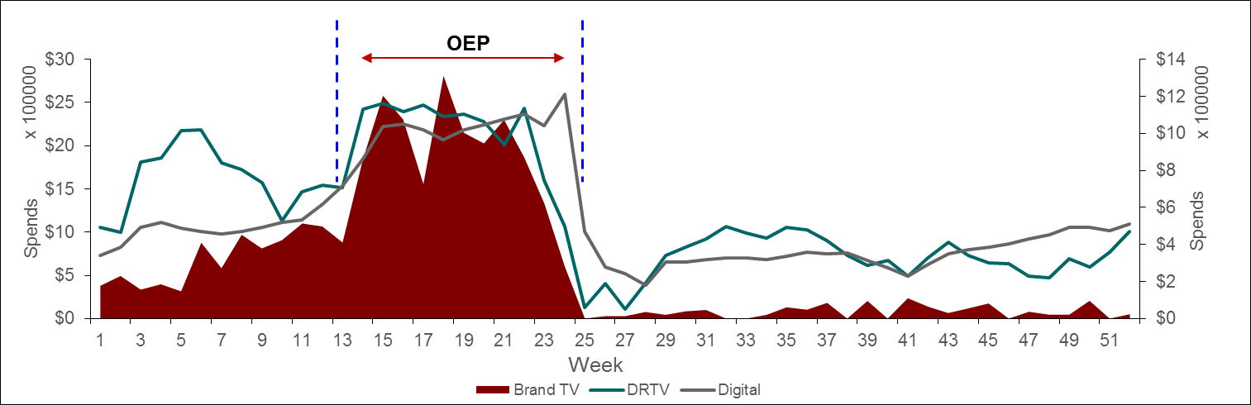

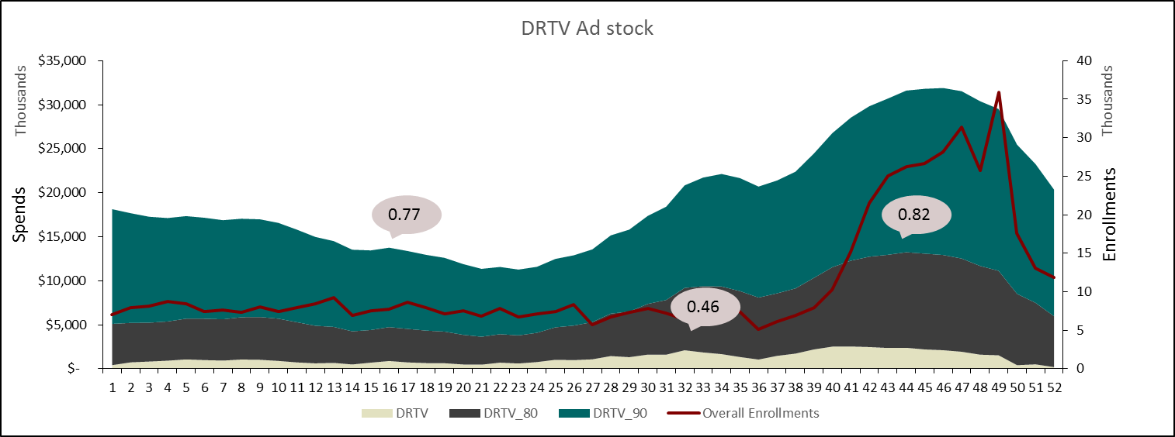


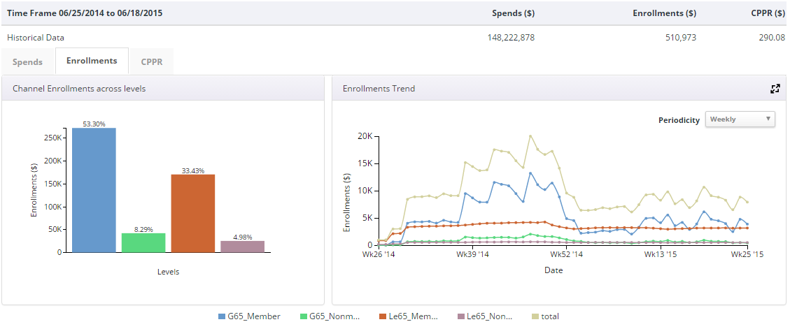



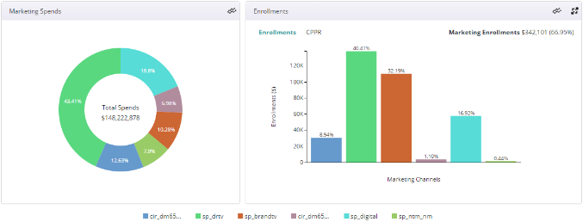
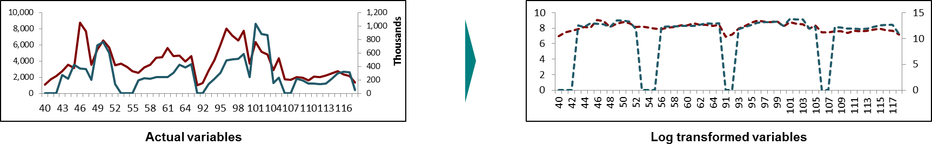
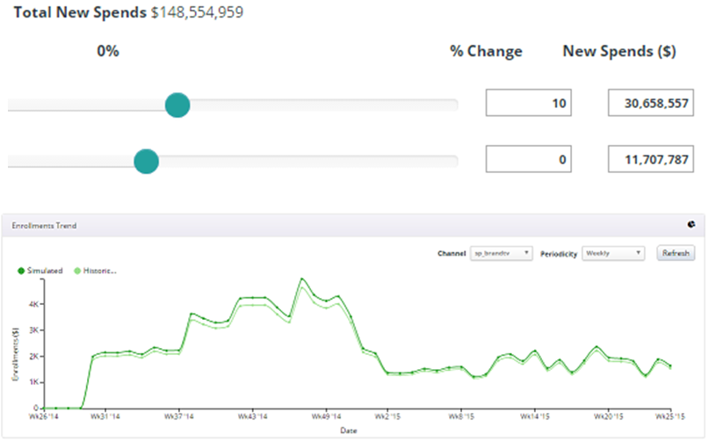
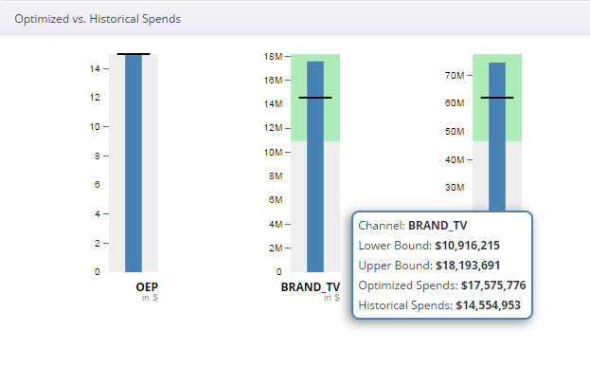
Market Mix Analysis is the first step towards getting a better understanding of the impact of marketing spends
Quality Analysis
Variable treatments
Customer Factors
Identify and classify advertising spends, trade promotional factors, sale assets and other factors
Prepare analytical data mart
Data Quality
Exploratory Data Analysis
Optimization & What-if Scenario Planning
Identifying Data
Statistical Modeling*
Seasonality
Promotional Lag / Ad stock effects
Event analysis
Halo and Synergy effects
Relationship analysis
Media Factors
Price Factors
Competitor Factors
External Factors
Determining the contribution of each marketing channel towards sales and comparing ROI
Optimization & What if scenario planning
Log-log Multiplicative linear modeling followed by
Mixed Modeling *
*exact modeling technique will be decided after initial analysis of data

Slide 32




Activation of integrated marketing insights is necessary to be delivered in near real-time for Business to see the results
Next Gen Focus Areas
What it covers?
What it covers?
Model customizations
Simulation/
Optimizations
Model stability and consistency
Reducing time to Insights
Driving activation of Insights
Testing/
Experimentation
What it covers?
What it covers?
Triangulate historical insights with results from experiments
Training on Consumption
Integrated marketing insights
Capability building
Continuous solution improvement

